Slide 1
FINDING NEW MEMBERS
& CLOSING SALES
For District 80
COT2
20 Feb 2016
www.toastmasters.org
Notes:
Welcome to the Toastmasters refreshed brand! Toastmasters International unveiled a new logo, tagline and positioning on Wednesday, August 17, 2011; the first day of International Convention.
The rebrand is a significant step forward in achieving the mission of Toastmasters International. By creating a consistent identity across the globe, we ignite efforts to build membership and increase recognition of the organization. This consistency will inform prospective members, regardless of location, that Toastmasters is the leading organization dedicated to helping them become the speakers and leaders they want to be. While this is not a radical change, the rebrand will take a concerted effort to make the transition across all districts and clubs. In this presentation I’m going to share with you:
An overview of branding.
The reasons why a rebrand was necessary.
The results of the research conducted to identify Toastmasters’ in the market place and in the minds of members and prospective members.
The Toastmasters brand position and visual system.
Club’s role in the brand refresh.

Slide 2
Finding New Members for Your Club
Let us share the benefits we have gained for ourselves with others.
– Dr. Ralph C. Smedley
1

Slide 3
Recruit New Members
Talk to friends, relatives, and co-workers
Wear a Toastmasters membership pin every day
Display the Toastmaster magazine
Distribute promotional brochures and fliers
Conduct a Speechcraft workshop
Create an account on a social networking website
2

Slide 4
Treat Guests Properly
Greet guests at the door as they arrive
Sit with a guest during the meeting
Speak with the guest after the meeting
Invite the guest to join members for any after-meeting socializing
Ask the guest to visit again
3

Slide 5
Keep it Personal
Always keep the club’s membership efforts personal, helpful, and friendly.
4

Slide 6
Keep it Personal
A guest never forgets the host who had treated him kindly. – Homer
5

Slide 7
The Successful Club Series
Closing the Sale
293

Slide 8
Meeting Standards
Meetings begin and end on time.
Participants arrive early and prepared.
Club officers fulfill their responsibilities.
The meeting proceeds at a good pace.
The members are enthusiastic.
Every project is a manual project.
1

Slide 9
Working Toward the Win-Win
Win-Win
Win-Lose
Lose-Lose
2

Slide 10
Discuss the Benefits
Improved speaking abilities
Leadership development
Better social skills
Greater self-esteem
3

Slide 11
Close that Sale
C ompare
L ose
O pinion
S tory
E xample
4

Slide 12
The Vice President Membership
A great help and asset!
5

Slide 13
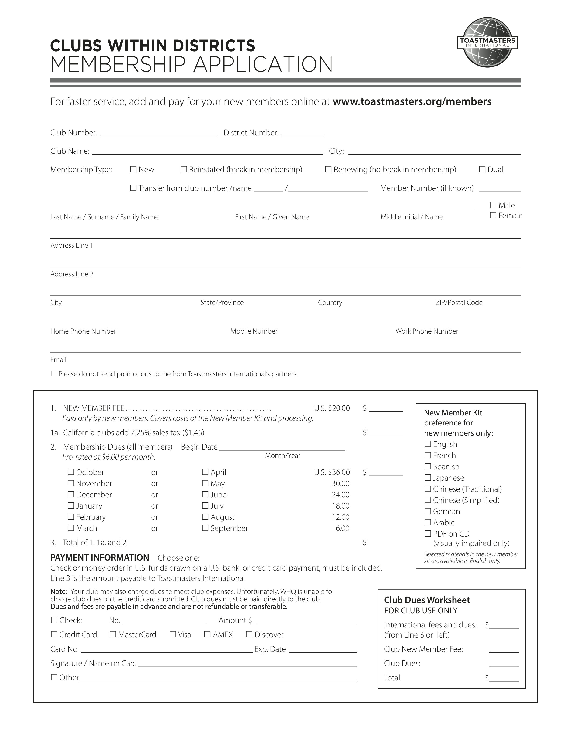
Filling Out the Application for Membership
6

Slide 14
Filling Out the Application for Membership
Member Status
New
Reinstated
Renewing
Dual
Transfer
7

Slide 15
Filling Out the Application for Membership
Financial
New members pay…
Transfer members…
All the above…
8

Slide 16
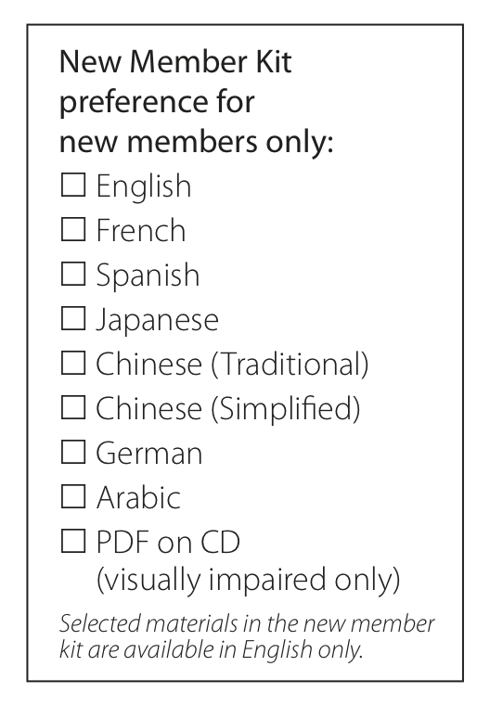
Filling Out the Application for Membership
Recruiter Information and Language Selection
9

Slide 17
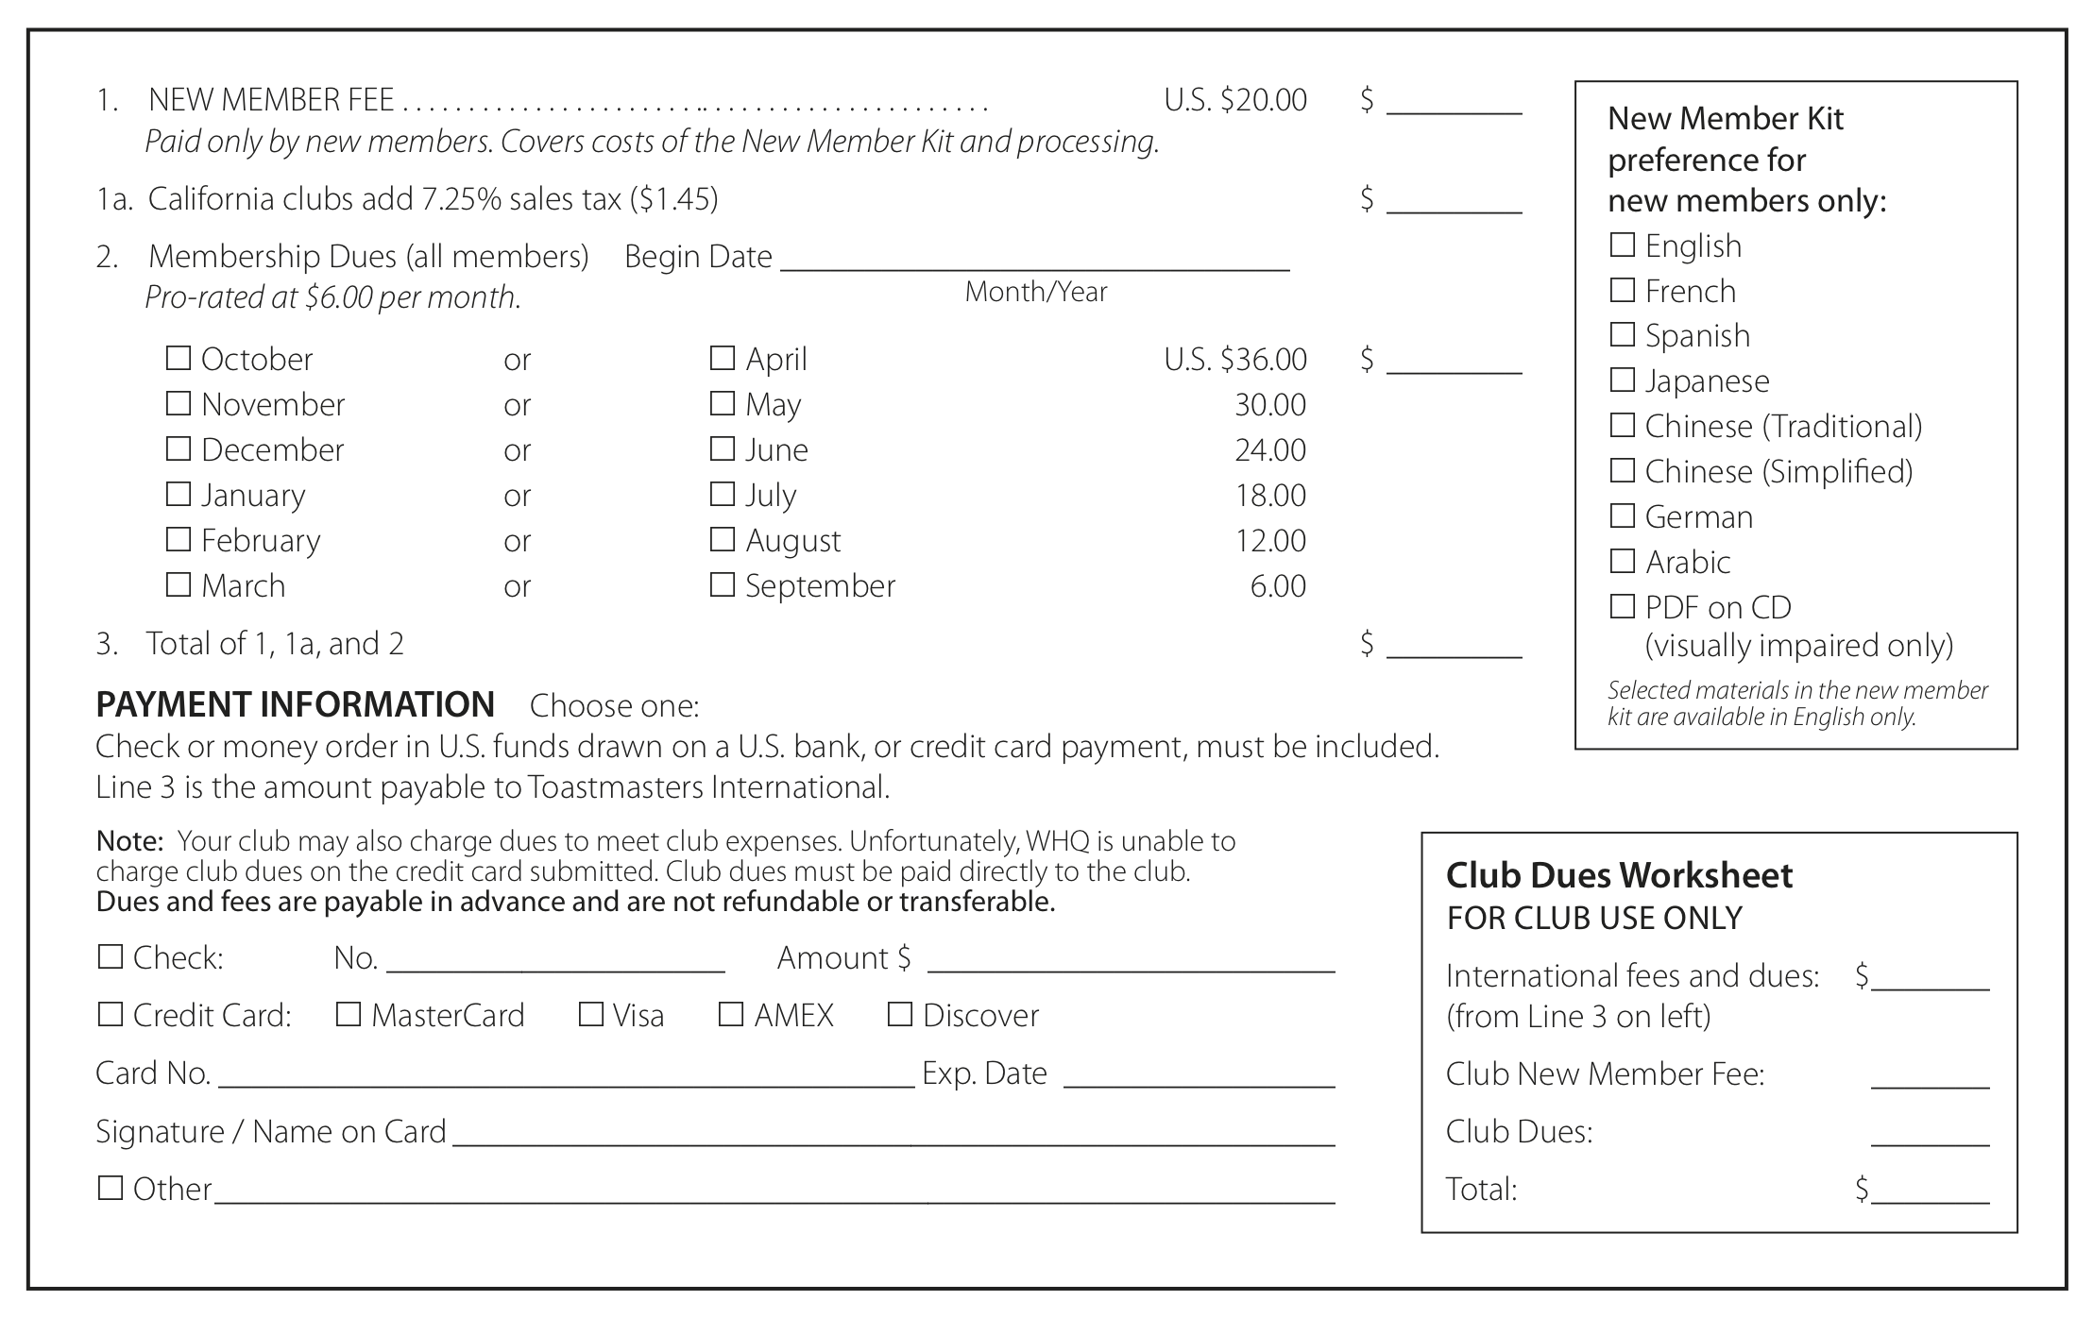
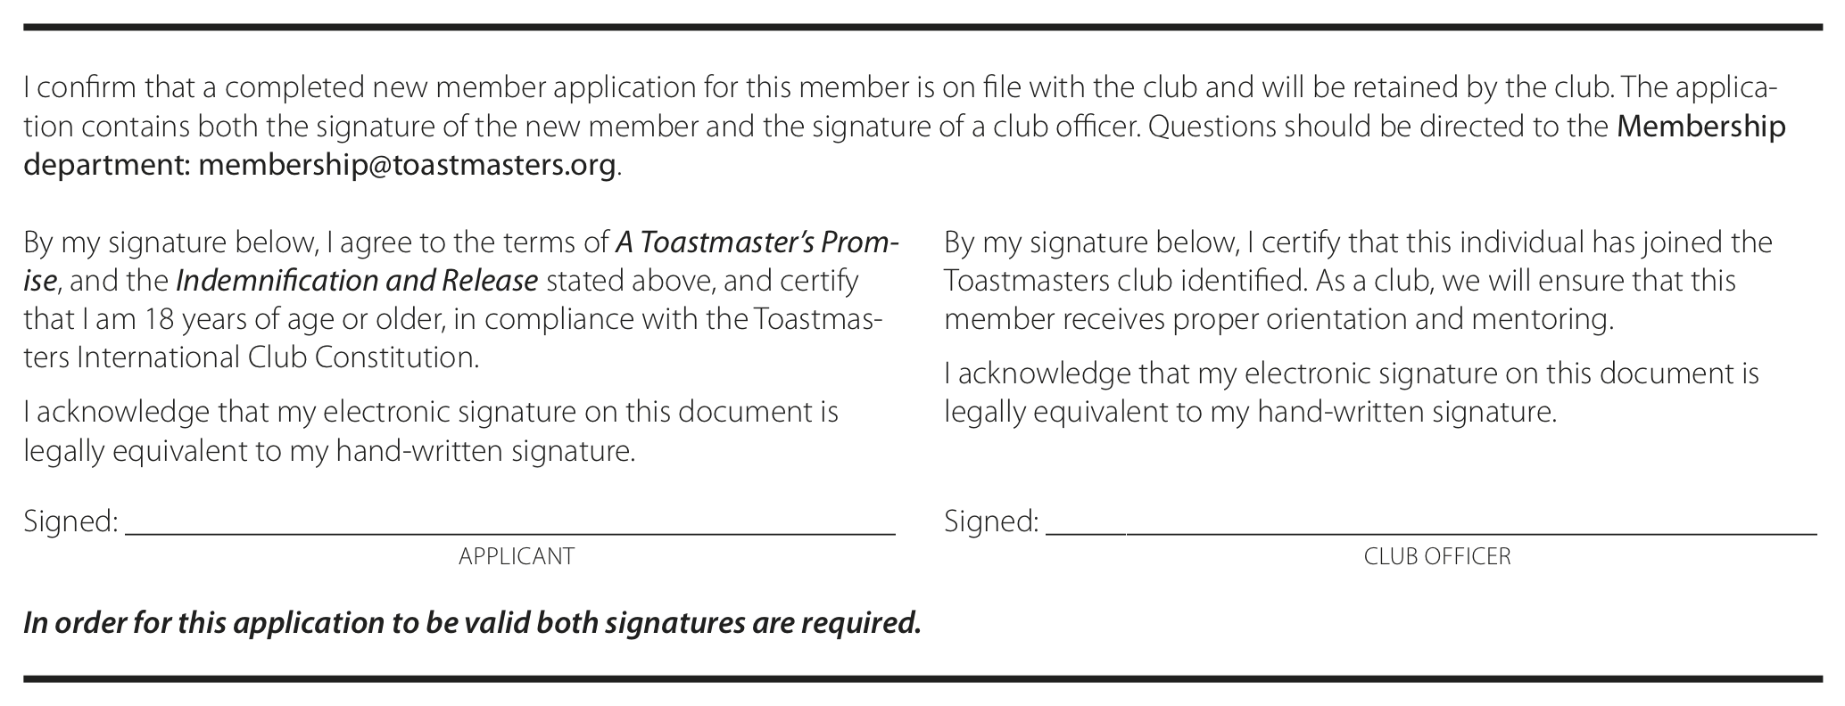
Filling Out the Application for Membership
Signatories and Payment
10

Slide 18
Conclusion
Enthusiasm
+ Techniques
+ Meeting roles
+ Mentor assistance
+ Materials and information
+ An official induction
= A Win-Win sale!
11

