Slide 1
District 80 2015-2016
Public Relations Strategies
Annabelle Fabia-de Arroz, DTM
Public Relations Manager-designate

Slide 2
Public Relations Manager
Responsible for coordinating publicity efforts in the district
Lead a District Public Relations Committee members

Slide 3
District 80 Public Relations
Internal Audience
External Audience
Toastmasters Members
Prospective Members
Local Media

Slide 4
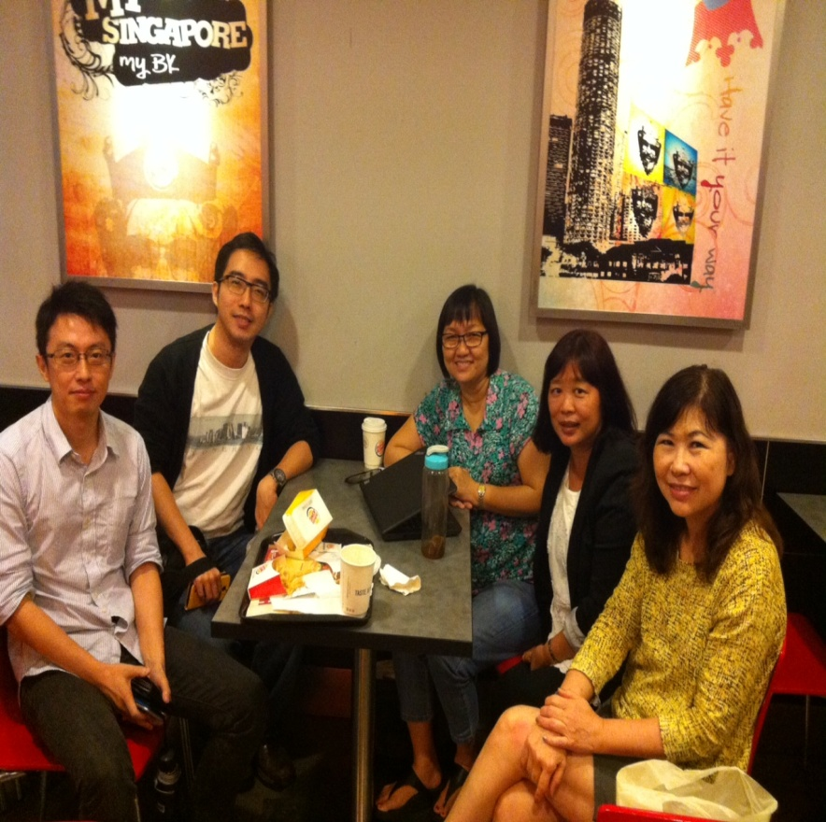
District 80 Public Relations Committee
Chay Wen Liang, ACG/CL – IT Media Committee
Daniel Zhuo – Co-IT Media Committee
Ida Lee, CC – Special Projects Committee
Helen Tan ACB/ALB – Editorial Committee
Division PRM – District PR Support Group

Slide 5
VISION:
A vibrant, established communication line that sufficiently inform and enhance the image of District 80 Toastmasters with its internal/external audience
MISSION:
To provide an accessible, engaging and vibrant publicity platform/endeavor to its internal/external audience in order to collaborate with District 80 officers/members to attain its goal of membership building and enhancing public awareness

Slide 6
STRATEGIES
Internal Audience
Regular and pro-active communication dissemination within the district
1. E-mail blast
2. E-newsletter
3. Internet Sites
*Platform: Website: www.district80.org
Facebookgroup: www.facebook.com/groups/mmmtm
Facebookpage: https://www.facebook.com/District80

Slide 7
Dialogue with Division DPR to assess effectivity of the DPR committee & updates at Division level Public Relations initiatives
Public Relations Campaign
e.g. Magazine, Video Contest, etc

Slide 8
External Audience
Creating Toastmasters brand awareness
outside the district
*Platform: Toastmasters Awareness Month
(TAM) Workshop
Campaigns – e.g. Flyers, Mainstream
media, Magazine,
etc

Slide 9
LAUNCHING:
***Video Competition
Rules:
1. Create a 2-3 min video in any public
place or event and ask any more than 2 non-
Toastmasters, “ Have you heard about
Toastmasters? If not, what do you
think it is?” Any additional spiels may be
added
2. Open to all District 80 Clubs and only 1 entry
per club
3. Participants must be 18 yrs old
and above

Slide 10
~Three winning entries will be selected by
the DPR team based on creativity and fun
aspects.
~Please submit entries to the DPR team on
or before 30 September 2015 via:
e-mail, District 80 FB sites message
~Winners will be announced 12 Oct 2015
and will be awarded at SAC 2015

Slide 11
*** Toastmasters Awareness Month (TAM)
Theme: INVEST IN YOURSELF, TRANSFORM YOUR LIFE
Workshop
When: 25 September 2015@ 7:00pm-9:30pm
Who: Public
Where: TBA

Slide 12
DPR Calendar:
2015
June Start Submission of Entries for Video
Competition
July Website, FB Update (on-going)
Start Submission/Collection of club
photos, articles for District 80
Magazine
Start of PR Campaign
August Dialogue with DVPR
Website, FB Update (on-going)

Slide 13
September TAM
Website, FB Update (ongoing)
October 2nd DEC/1st DCM DPR Report
Newsletter
Video Campaign Conclusion
PR Campaign
Website, FB Update (ongoing)
Deadline for Magazine
Contributions (20 October 2015)
November DVPR Dialogue
Website, FB Update (ongoing)

Slide 14
December DPR Campaign
Website, FB Update (ongoing)
January-February
Newsletter
Magazine Publication or earlier
Website, FB Update (ongoing)
DPR Campaign
March DVPR Dialogue
Website, FB Update (ongoing)
DPR Campaign

Slide 15
April Website, FB Update (ongoing)
DPR Campaign
Succession Planning
May 3rd DEC/2nd DCM DPR Report
Website, FB Update (ongoing)
DPR Campaign
June Newsletter
Website, FB Update (on-going)
DPR Campaign Conclusion
Turn-over Initiatives to Incoming
DPR 2016-2017

Slide 16
THANK YOU

