Slide 1
Area and Division Director Training
New Club
Mentoring Matters
218G

Slide 2
Session Objectives
Introduction
Teaching Toastmasters to fish
Official duties
Quality club meetings
Membership muscle
Keep them coming back
The educational program
The Distinguished Club Program
1

Slide 3
Introduction
Plato – mentored by Socrates
Alexander the Great – mentored by Aristotle
Helen Keller – mentored by Anne Sullivan
2

Slide 4
The Values of Mentoring
Share their expertise.
Develop their capacity to translate values and strategies into productive actions.
Prove themselves as valuable leaders.
Invest in the future of Toastmasters.
Obtain fresh perspectives.
Build teamwork skills.
Expose themselves to new situations in which to apply their skills.
Earn credit toward the Advanced Leader Silver (ALS) award.
3

Slide 5
Appointing Mentors
The district director is responsible for appointing all mentors for new Toastmasters clubs.
The district can also email newclubs@ toastmasters.org to appoint sponsors.
The names of sponsors and mentors must be assigned and appear on the Application to Organize form that is sent to World Headquarters.
4

Slide 6
The Team Approach
A sponsor is a member who:
Helps charter a new club.
Follows leads.
Generates interest and enthusiasm for the new club.
Recruits members.
Gets all of the appropriate paperwork submitted to World Headquarters.
5

Slide 7
Teaching Toastmasters to Fish
Toastmasters Teamwork
Give a man a fish and you feed him for a day. Teach a man to fish and you feed him for a lifetime.
6

Slide 8
Answering Questions
1) No. Evaluators are simply individuals offering their opinions and perceptions of a speech or performance. If a speech does not meet project objectives, an evaluator should point out what the speaker did well and also point out the areas where the speaker could improve, as in a normal evaluation. The evaluator could then suggest, in private, that the speaker repeat the project. Ultimately, the member must decide if the evaluator’s opinion is valid and if a speech project should be repeated.
7

Slide 9
Answering Questions
2) No. One of the lessons to be practiced in speech training is that of expressing a thought within a specific time. Timing is treated the same as any other manual project objective. For example, if one of the objectives of a project speech is to use gestures effectively and the member focuses instead on vocal variety, the member has not met the project objective and the evaluator should point this out. The same is true if the time for a speech is five to seven minutes and the member speaks for eight minutes. The evaluator should point out that the timing objective for the speech was not met.
8

Slide 10
Answering Questions
3) No. The Toastmasters program is self-motivated and self-paced. If a member chooses not to do his best when completing projects, that is his choice. Although the VPE certainly can encourage the member to do better, the VPE does not have the authority to refuse to sign the Project Completion Record. Keep in mind, too, that people’s natural abilities vary. For example, one person may devote 10-12 hours preparing a speech and struggle with meeting project objectives or not meet them at all. But that person did the best they could. Another member working on the same project may devote only one to two hours of preparation and meet all of the objectives with ease. The VPE should be sensitive to this.
9

Slide 11
Answering Questions
4) Some clubs vote for Best Speaker of the meeting or most improved speaker. However, not all clubs choose to recognize members in this way. Because this recognition is optional, each club is free to set its own requirements for this award.
10

Slide 12
Answering Questions
5) Some clubs vote for Best Table Topics™ speaker. This recognition is optional so each club is free to decide who is permitted to vote.
11

Slide 13
Using the Resources
Updates on the club’s progress in the DCP
Downloadable forms and documents
Perform administrative tasks
Current and back issues of the Leader Letter
12

Slide 14
Official Duties
Ensure the club is strong and fully functional.
Make sure officers understand their duties and have the tools they need to perform them.
13

Slide 15
What? How? Why?
What they must do
How they must go about doing it
Why their actions or inaction affects every individual member and the club as a whole
14

Slide 16
Optional
What aspects of a club are optional?
15

Slide 17
Quality Club Meetings
The backbone of successful meetings is preparation.
Show VPEs how to find and use other tools like the free meeting-planning software available from the Toastmasters website.
Familiarize the VPE with other ideal programming materials.
Create a member service perspective.
Encourage clubs to conduct the presentation “Moments of Truth” from The Successful Club Series.
16

Slide 18
Membership Muscle
Maintain a strong and healthy membership of at least 20 members.
Strive to bring in new members.
Foster a membership-building culture within the new clubs, which helps them combat natural attrition.
17

Slide 19
Membership Muscle
Involve the VPM
Encourage the vice president membership (VPM) to develop and implement a club-sponsored membership contest to run the duration of their term.
18

Slide 20
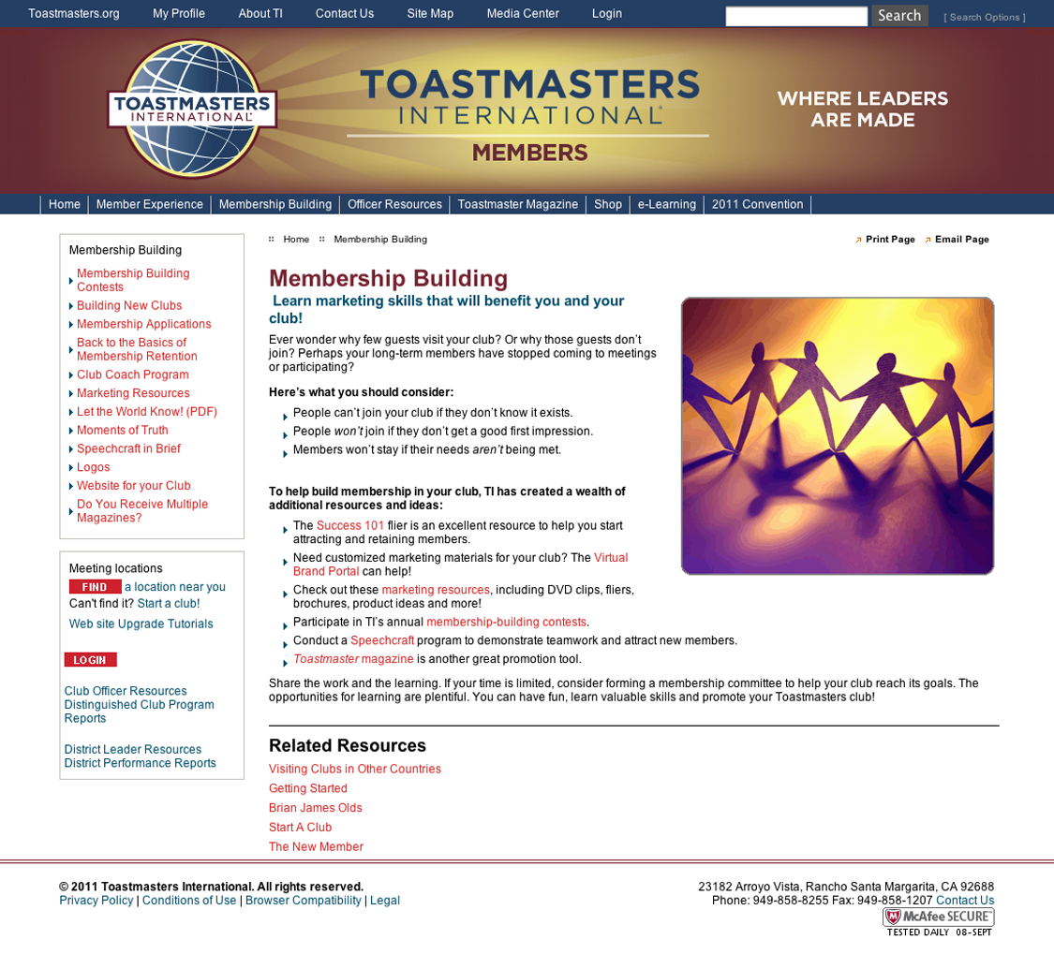
Membership Muscle
Membership-Building Contest
www.toastmasters.org/membershipbuilding
19

Slide 21
Membership Muscle
Promotional Strategies
What are some examples of simple promotional strategies?
20

Slide 22
Membership Muscle
Member Retention
Retention of current members is important to a club’s longevity and performance.
Retaining members provides continuity in the club and assures a strong leadership base.
The entire club is responsible for keeping its members satisfied and involved in the program.
21

Slide 23
Keep Them Coming Back
Emphasize the importance of recognizing members who work toward their goals.
Suggest to company clubs that they use the company’s email, intranet, and newsletter to congratulate members who have earned educational awards or won a speech contest.
Publicize the club’s achievement in the Distinguished Club Program.
22

Slide 24
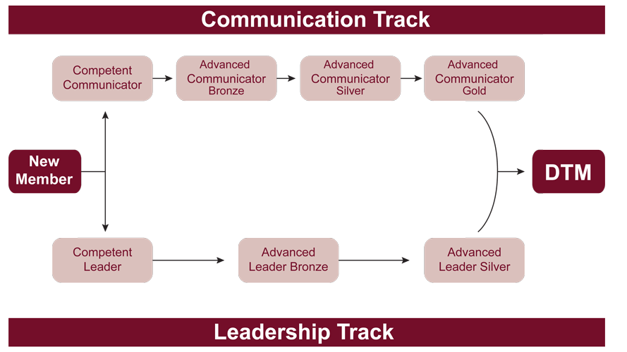
The Educational Program
23

Slide 25
The DCP Can Help
Make sure officers know where to find the Distinguished Club Program and Club Success Plan online at www.toastmasters.org/1111.
Advise the club to present The Successful Club Series module, “How to be a Distinguished Club” at least once every year.
Recommend the club use and display the Distinguished Club Program Goals Wall Chart.
Ensure the club knows how to use the Club Success Plan.
24

Slide 26
Closing
“The beginning is the most important part of the work.”
Plato, The Republic
25

