Slide 1
Area and Division Director Training
Starting From Scratch
How to Sponsor New Clubs
218H

Slide 2
Introduction
Enhance your leadership skills.
Develop project-management proficiency.
Expand your marketing expertise.
1

Slide 3
Session Objectives
A sponsor’s duties
Cultivate a corporate club
Launch a community club
Feed their enthusiasm
Complete the charter
Plan the presentation
2

Slide 4
A Sponsor’s Duties
Organize the new club.
Set up regular club meetings.
Complete the paperwork and plan the charter presentation.
3

Slide 5
Types of Clubs
Corporate
Community
Advanced
Specialty
4

Slide 6
Cultivate a Corporate Club
The New Club Information Kit
How to Build a Toastmasters Club
Forms
Promotional materials
5

Slide 7
Cultivate a Corporate Club
Toastmasters Teamwork
Two sponsors
Two mentors
The District Director
The Club Growth Director
other Toastmasters and district leaders
6

Slide 8
Cultivate a Corporate Club
Identify Your Target
Company
Size
Location
Revenue
Key contacts and decision-makers
Other company information
Recent news articles
7

Slide 9
Cultivate a Corporate Club
Introduce Yourself
8

Slide 10
Cultivate a Corporate Club
After the Introduction
1. Set an appointment.
2. Prepare for the meeting.
3. Share about other corporations.
4. Wrap it up.
9

Slide 11
Cultivate a Corporate Club
Discussing the Finances
Finalize its financial commitment.
Determine what portion of the club costs the company will pay.
10

Slide 12
Cultivate a Corporate Club
Money Matters
Designate a club officer to hold the payments.
Hold the payments until they are sent to Toastmasters International.
Deposit the payment into another club’s account.
11

Slide 13
Cultivate a Corporate Club
The Demonstration Meeting
Toastmaster
Timer
Ah-Counter
Grammarian
General Evaluator
Speaker
Evaluator
Topicsmaster
12

Slide 14
Cultivate a Corporate Club
The Demonstration Meeting
Keep the meeting short and within time limits.
Include 3 aspects, if time is limited.
Select a demonstration meeting team.
Select Toastmasters to assume various roles.
Invite high-level representatives.
Have each guest sign a guest book.
13

Slide 15
Cultivate a Corporate Club
The Demonstration Meeting
Before the demonstration…
During the demonstration…
14

Slide 16
Cultivate a Corporate Club
After the Demonstration Meeting
Introduce the sponsors and mentors.
Conduct a brief question-and-answer session.
Ask Toastmasters members to share success stories.
Complete the Application to Organize form.
Submit the Application to Organize to World Headquarters with the charter fee.
15

Slide 17
Launch a Community Club
Toastmasters Teamwork
Two sponsors
Two mentors
The District Director
The Club Growth Director
Other Toastmasters and district leaders
16

Slide 18
Launch a Community Club
Steps to Chartering
Plan a demonstration meeting.
Publicize the meeting.
Contact the local chamber of commerce.
Display posters and announcements.
Target specialized groups.
17

Slide 19
Feed Their Enthusiasm
Steps to Chartering
Announce the next meeting.
Select temporary officers.
Follow up with reminder notices.
Collect money from those who have decided to join.
Obtain enough money to pay the charter fee.
Conclude with recognition.
18

Slide 20
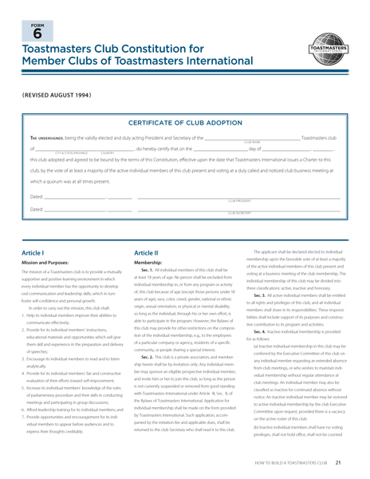
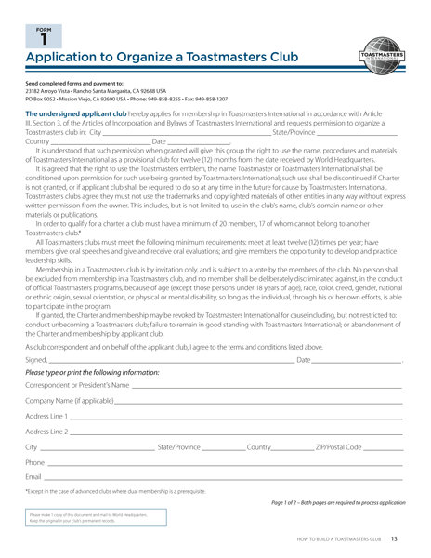
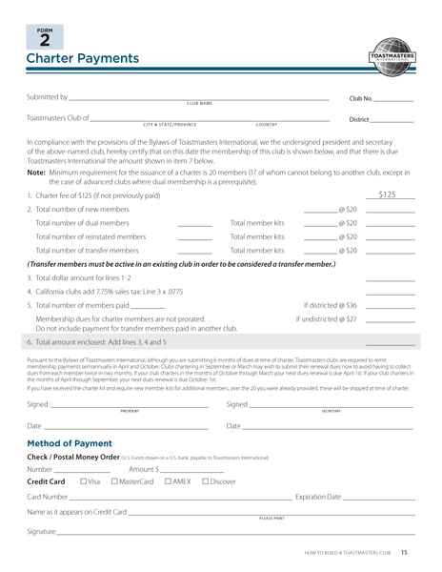
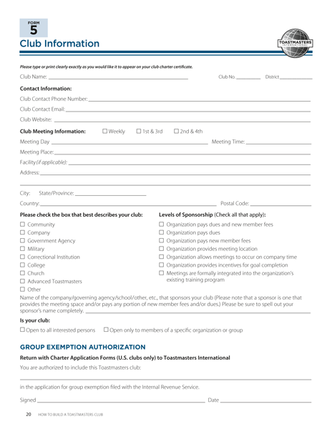
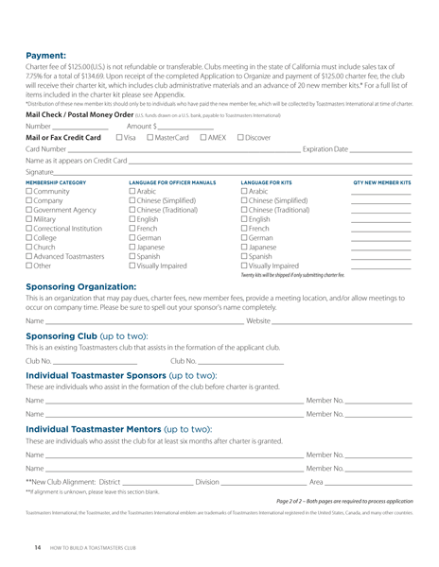
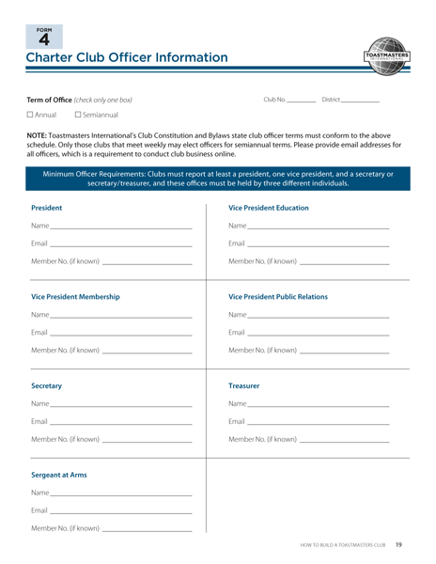
Complete the Charter
Charter Forms Checklist
19

Slide 21
Plan the Presentation
Invite the guests.
Plan the meal.
Publicize the charter presentation.
Form committees.
Include a short meeting.
Prepare a printed program.
20

Slide 22
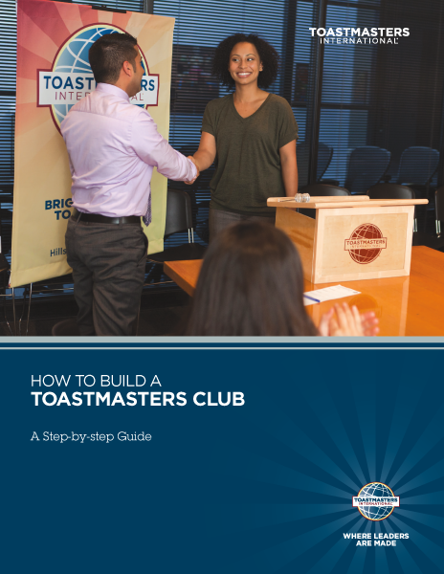
Closing
21

