Slide 1
DIVISION FINANCE
Azizah Sapari DTM
District Finance Manager
2015-2016
District 80 Executive Council Meeting
13 June 2015

Slide 2
Source of Authority
TI Policies and Protocol -
Policy 8.4 District Fiscal Management
Protocol 8.4 District Fiscal Management
Reference :
GOVERNING DOCUMENTS OF TOASTMASTERS INTERNATIONAL
https://www.toastmasters.org/Leadership-Central/Governing-Documents

Slide 3
Important Notes
TI Policies and Protocols are updated regularly
Always refer to the latest TI Policies and Protocol

Slide 4
Outline
DISTRICT FUNDS
DIVISION FINANCE
FUNDS ALLOCATION
DIVISION CLAIMS

Slide 5
DISTRICT FUNDS

Slide 6
Ownership of Funds
All district funds are TI funds to be used for carrying out TI and district missions

Slide 7
District Funds
May be used for :
District and club leader training
Club growth and retention
Supporting clubs in their membership growth efforts
Promotion of Toastmasters International educational programs within clubs
District leader travel, communications, administrative materials, awards and recognition items, district meetings, and speech contests conducted by the district.
Shall not be used for :
Meetings outside the district
Membership and club dues or fees.
Donation to any charitable fund (including Ralph C.Smedley Memorial Fund)

Slide 8
2. DIVISION FINANCE

Slide 9
Division Finance Management
Division is allocated funds from district
Division has its own budget
Division budget is part of district budget

Slide 10
Division & Area Financial Activities
Subject to District Director’s supervision
Monthly Division and Area financial activities reports are to be sent to District Finance Manager within 30 days of the end of the month

Slide 11
Administration of Division / Area Funds
Funds in division / area bank accounts
- Owned by district / TI
Administration of funds
- To follow the same rules for district funds

Slide 12
3. FUNDS ALLOCATION

Slide 13
Funds for Divisions
Amount of provision is :
based on active (PAID) clubs in the division on TI record as at 1st July 2015
S$150 per club

Slide 14
Division Expenditure Limits
S/N | Item | Expenditure Limit *
1 | Marketing | < 45%
2 | Education & Training | < 30%
3 | Administration | < 20%
4 | Speech Contests | < S$1,000
5 | Others | < 10%
* of the total amount of funds allocated for the division

Slide 15
Example : Creation of Division Budget with 20 Clubs
Allocated Fund for 20 clubs @ S$150 per club = S$150 X 20 = S$3000
S/N | Item | Expenditure Limit | Max Amount (S$) | Division Budget (S$)
1 | Marketing | < 45% | < S$1,350 | S$1,000
2 | Education & Training | < 30% | < S$900 | S$700
3 | Administration | < 20% | < S$600 | S$400
4 | Speech Contests | < S$1,000 | < S$1,000 | S$800
5 | Others | < 10% | < S$300 | S$100
 |  |  |  | S$3,000

Slide 16
DISTRICT 80
Division Expenses Categorization
 | ACCEPTABLE | UNACCEPTABLE
Marketing | Supply catalogue gift certificates and other items obtained from WHQ relating to marketing | All items of expenses which do not directly or indirectly relate to the District and Club mission
 | Cost of paper, printing, copying (all of this must relate to Division programs to facilitate Division wide marketing campaign for the charter of new clubs and increase in membership base) | All personal purchase and consumption of meals, liquor and/or entertainment expenses

Slide 17
DISTRICT 80
Division Expenses Categorization
 | ACCEPTABLE | UNACCEPTABLE
Education & Training Expenses | Club Officer Training Expenses | Copying TI materials not readily made available for education and training or members in direct infringement of TI copyright
 | Printing TI educational materials from TI resource for purposes of training | Certificates, plaques, trophies not purchased from WHQ that bear the name “Toastmasters,” “Toastmasters International,” or the Toastmasters International emblem/logo which infringe TI copyright

Slide 18
DISTRICT 80
Division Expenses Categorization
 | ACCEPTABLE | UNACCEPTABLE
Speech Contests | Trophies, plaques and certificates purchased from Toastmasters International | Cash awards
 | Postage | Certificates, plaques, trophies not purchased from World Headquarter that bear the name “Toastmasters,” “Toastmasters International,” or the Toastmasters International emblem/logo

Slide 19
DISTRICT 80
Division Expenses Categorization
 | ACCEPTABLE | UNACCEPTABLE
Admin | Stationery | Undocumented reimbursement requests
 | Office supplies | Travel
Others | Items of expense not listed above but which relate directly to Division, education, training and marketing goals (including and not limited to formation of new clubs, membership recruitment and retention)

Slide 20
Summary : Primary Use
Training club officers
Club growth & retention
Membership growth
Educational achievements
Awards & recognition items
Speech contests

Slide 21
Summary : Unacceptable Expenses
Personal expenses
Free meals, entertainment
Cash / Vouchers
Items bearing TI name / logo NOT purchased from TI
Acceptable expenses at excessively high cost
Travel
Club charter fees / dues
Duplicate Expenses
Recognition
Websites

Slide 22
4. DIVISION CLAIMS

Slide 23
Division Claims
On reimbursement basis
No request for advance

Slide 24
Expense Documentation
Claims must be supported by original receipts
If an original receipt is lost, a detailed written and endorsed explanation is required

Slide 25
Expense Approval
DD – Approving Officer
A single expenditure in excess of S$600 must be authorized in advance in writing by the DD and one other (either the CGD or PQD)

Slide 26
Some Policies
Reimbursement requests must be made within 60 days of incurring the expense and by 10 June 2016 for expenses incurred in June 2016.
Reimbursement by a district must be made within 60 days after receipt of an authorized reimbursement request.

Slide 27
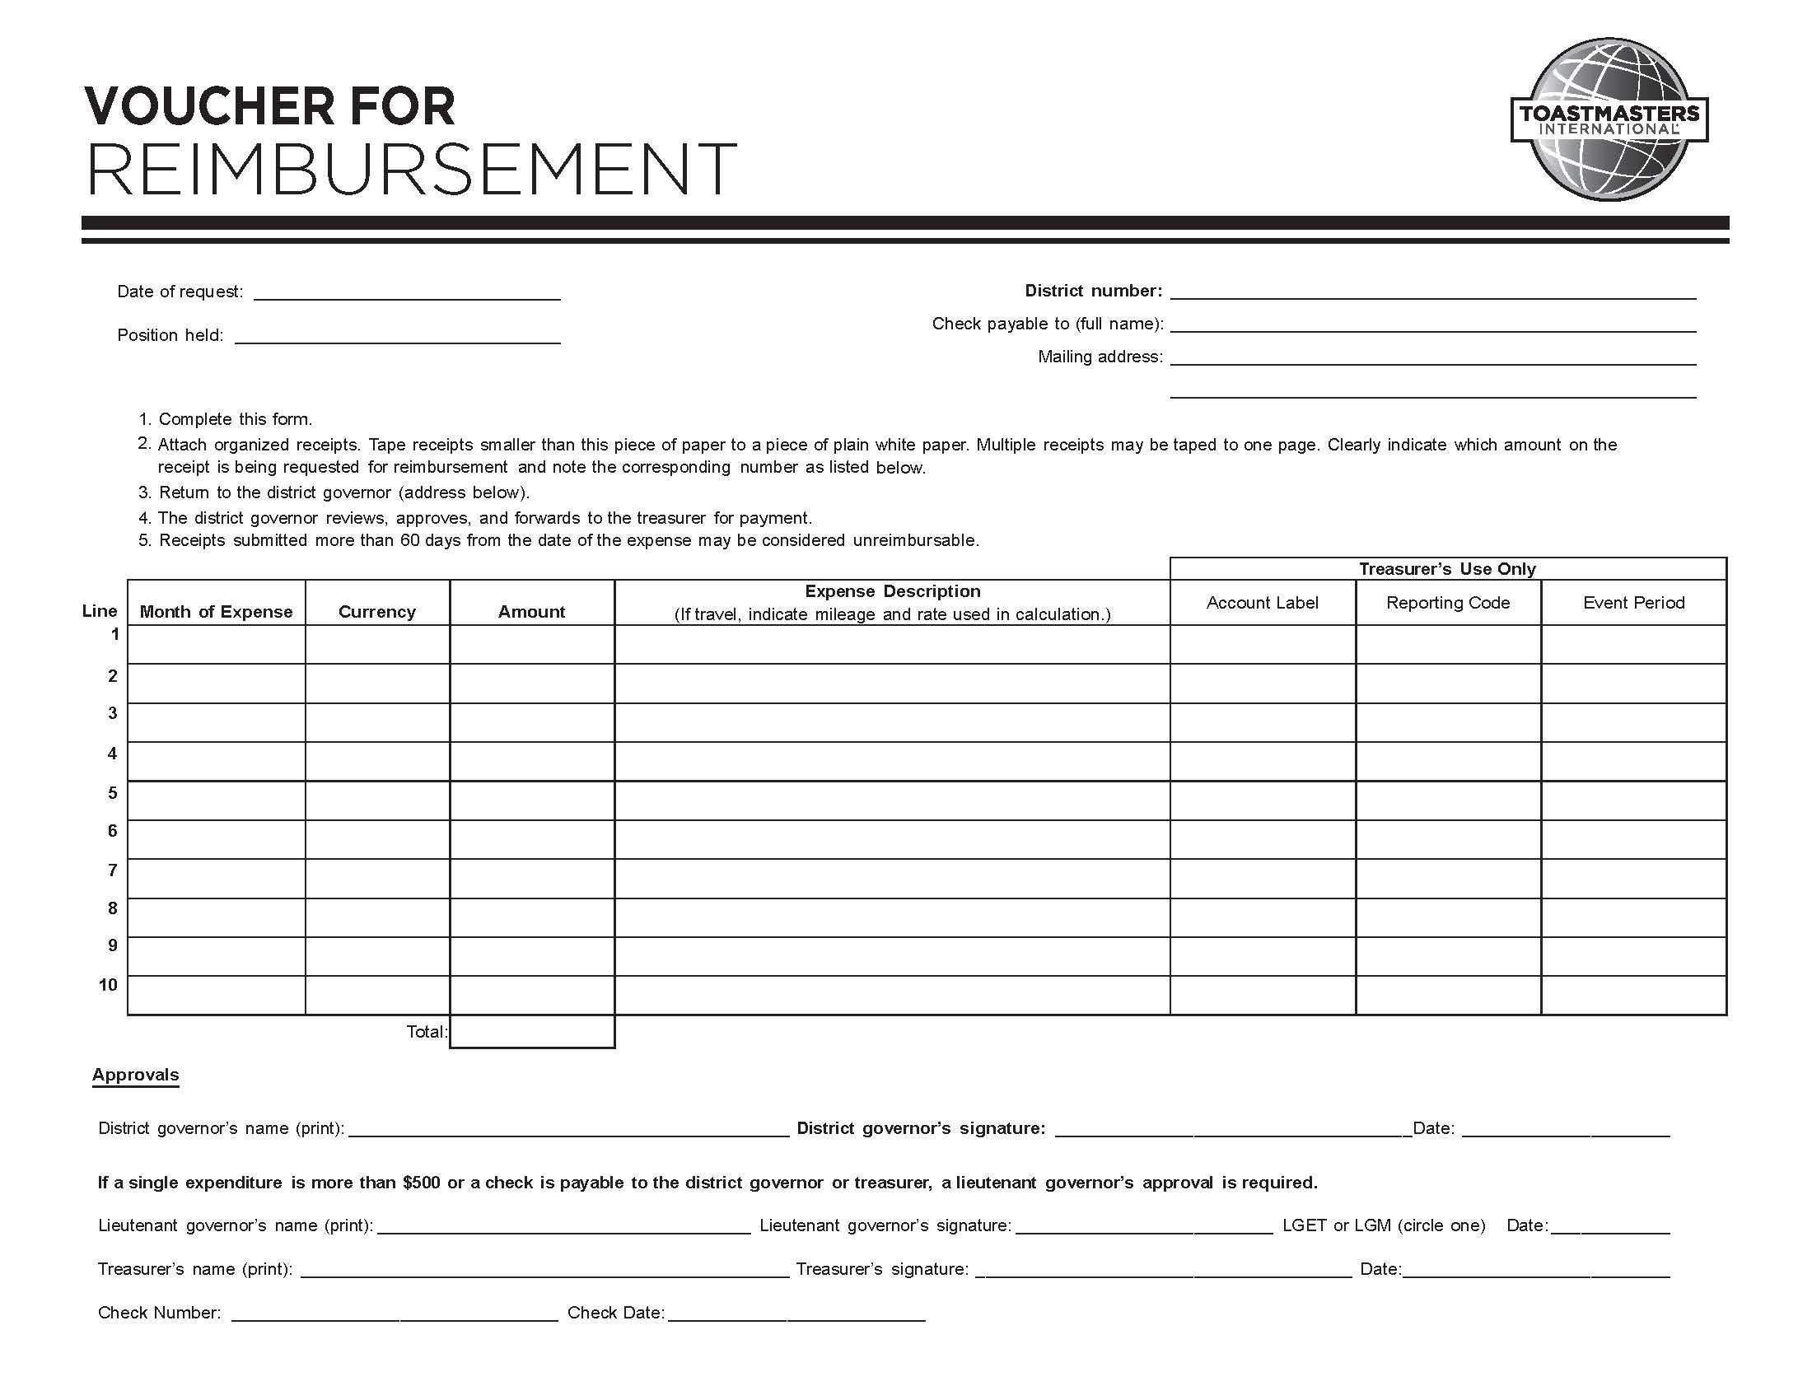
Finance Manager’s Workflow
Finance Manager checks and prepares cheque
Finance Manager seeks District Director’s approval
Finance Manager issues cheque
Finance Manager receives duly-filled Voucher
Reimbursement
Voucher

Slide 29
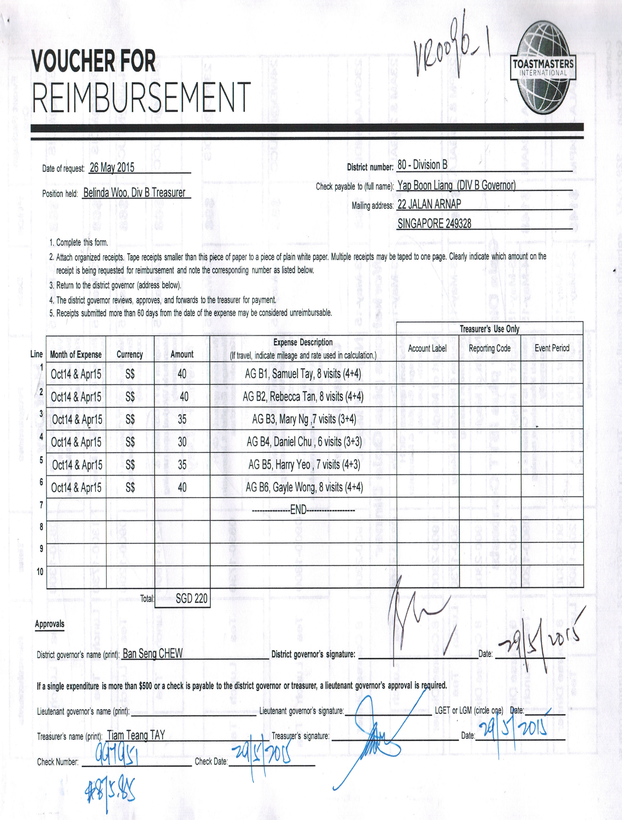

Slide 30
Important Deadlines
Last claim submission
10 June 2016
Last cheque issue
30 June 2016
Last cheque clearance
15 July 2016

Slide 31
Conclusion
District Funds
Division Finance
Funds Allocation
Division Claims

Slide 32
Thank you !

