Slide 1
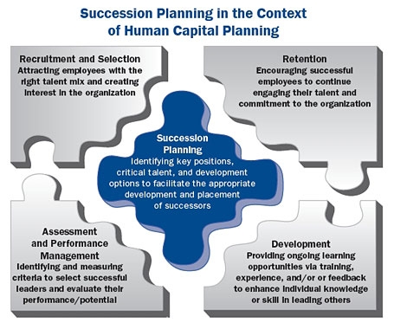
CLUB OFFICERS TRAINING
=

Slide 4
What Is Succession Planning?
A process for identifying and developing internal people with the potential to fill key leadership positions in the organisation.
Ensures the continued effective performance of an organisation by establishing a process to develop critical competencies and replace key staff over time.

Slide 5
Program Participation
Recruit and develop potentially bright individuals who appreciate recognition.
Voluntary opt-in.
Leadership Competencies - Defines attributes desired.
What an employee must achieve to show proficiency at each level.
Examples: Effectiveness, communication, ethics, knowledge, developing people, flexibility/adaptability, strategic initiative, effective decision making, customer orientation, achievement orientation, team orientation.

Slide 8
Mentoring is key to preparing ‘Next In Line’.

Slide 11
Qualifications of District Officers
Area Governor (Area Director)
As far as practical, served as member of District Council
Serve as Club President (Recommended)
Division Governor (Division Director)
At least 6 consecutive months as member of District Council
Served as Area Governor (Recommended)
Served as Club President

Slide 12
CLUB OFFICERS TRAINING

